Slide 1
Brief Introduction to Github
Lukas Hoffmann, 8/28/17

Slide 2
Why Github?
git versus Github
Github: version control for collaborative projects
Who changed what, when, and why
Distributed: work on different parts, at different times, in different locations, then merge changes smoothly
Complete project history & documentation
Open access reproducible research
Social network for coders

Slide 3
Example: one-user, one-branch Github pipeline

Slide 4
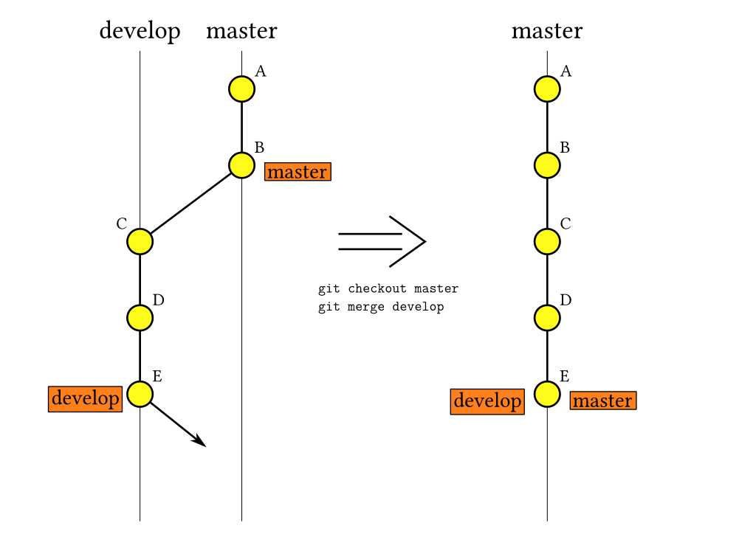
What we’re doing, high-level

Slide 5
Prerequisites
Innumerable online resources: github.com/lahoffm/github_help
Need Github account
Need git command line tool
git-for-windows.github.io/ - Git Bash is great (Windows)
git-scm.com/
Set up some configs: swcarpentry.github.io/git-novice/02-setup/
Set up credentials so it doesn’t always ask for password (not sure how to do this step by step): help.github.com/articles/why-is-git-always-asking-for-my-password/
git help
Free stuff with .edu address: education.github.com/pack

Slide 6
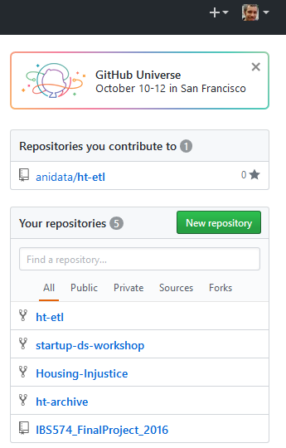
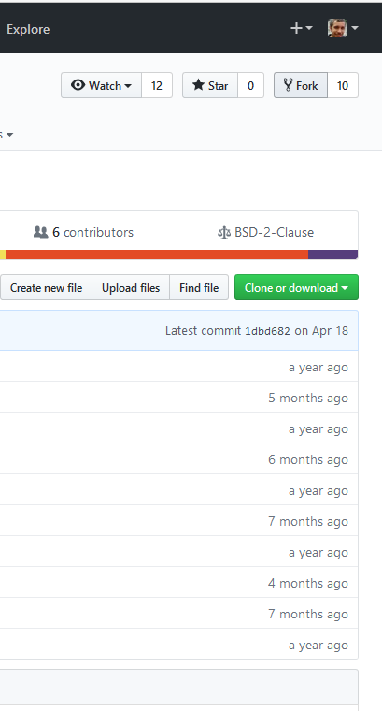
Make new repository or fork repository
Or git init
with a few
more steps

Slide 7
Setup a new repo
Pick a license
MIT, Apache, GPL, ...
choosealicense.com/
.gitignore - specifies intentionally untracked files to ignore
Thumbs.db = ignore Thumbs.db files in any folder
/*.txt = ignore all .txt files in current folder
/data/*.txt = ignore all .txt files in data folder
README.md
On command line (or Git Bash)
cd to your folder
git clone https://github.com/username/reponame
cd reponame
Subsequent git commands should be run inside the reponame folder
Notes:
/data/* or /data/** could make it delete things you don’t want, see https://web.archive.org/web/20140310215100/http://blog.icefusion.co.uk:80/git-stash-can-delete-ignored-files-git-stash-u/
If you add a .gitignore *.txt, but there was previously a tracked .txt file that you had committed, it won’t ignore that file. You can first remove that file from the repo, do a commit, then re-add it to the repo (then it will get ignored). Or use git rm --cached file_to_ignore.txt

Slide 8
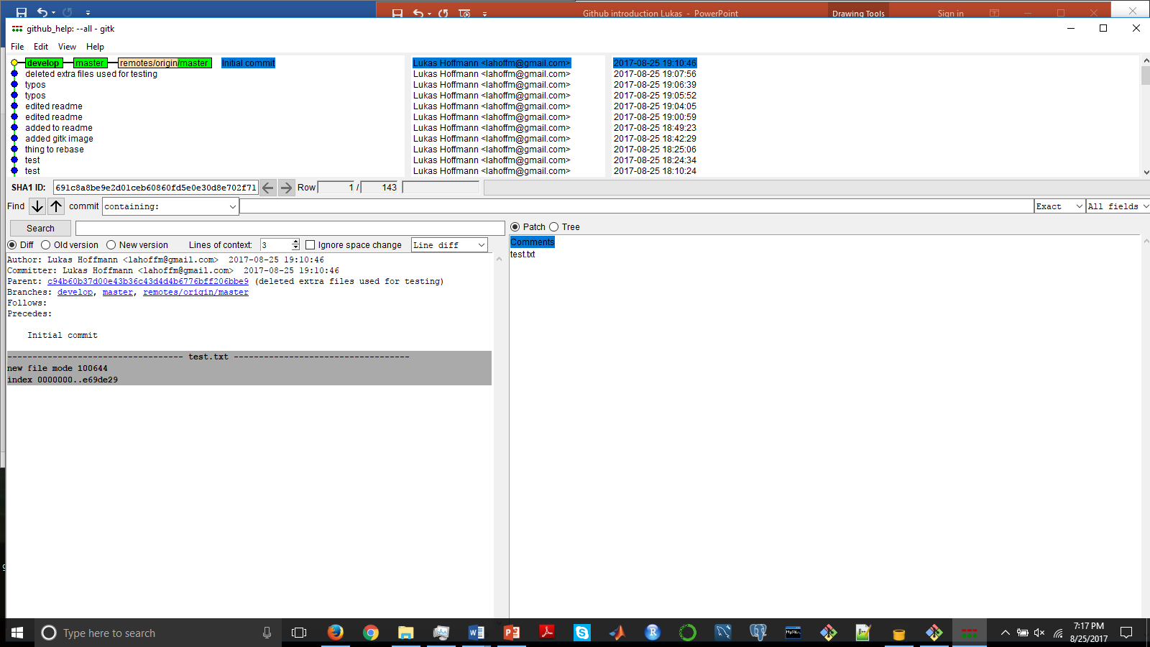
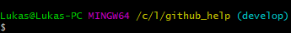
Switch to development branch
git checkout –b develop - create branch & switch to it
Call it whatever you want – this example called it ‘develop’
git branch – list branches in repo & current branch
gitk --all – see your current commit tree
lostechies.com/joshuaflanagan/2010/09/03/use-gitk-to-understand-git/
In Git bash it should show your current branch

Slide 9
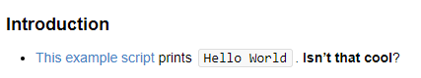
Start hacking
Add src/helloworld.py
print(“Hello World”)
Add documentation to README.md
### Introduction
[This example script](src/helloworld.py) prints ```Hello World```. **Isn't that cool**?
Markdown syntax: guides.github.com/pdfs/markdown-cheatsheet-online.pdf
Markdown preview for Google Chrome: MarkView

Slide 10
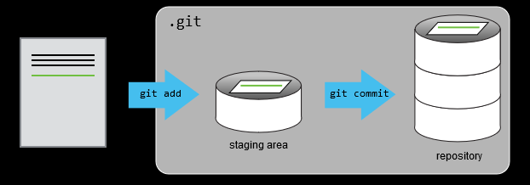
Stage and commit
git status – shows project status
“Git sees every file in your working copy as one of three things:
tracked - a file which has been previously staged or committed;
untracked - a file which has not been staged or committed; or
ignored - a file which Git has been explicitly told to ignore.” (Slideshare)
git add –A – track all files
git commit –am “Added helloworld script”
- commit changes on current branch
Notes:
"remote" is just some git repository not on your computer (e.g. on github). "origin" is the repository you cloned your repository from (e.g. the one on your github). "master" is just the name of the default branch. ... Origin is the default name for a remote repository, but you may change that. https://www.quora.com/What-does-git-remote-and-origin-mean

Slide 11
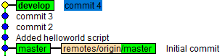
Make some more commits
Hack, git add –A; git commit –am “commit 2”
Hack, git add –A; git commit –am “commit 3”
Hack, git add –A; git commit –am “commit 4”
Commit tree looks like this now:
Don’t have to use git add if you’re not adding or moving files but it’s safest way to ensure everything is tracked on a commit

Slide 12
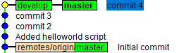
Merge branch to master
git checkout master – switch back to master branch
Your src/helloworld.py disappeared! Don’t panic. When a branch is checked out you’re seeing repo from that branch’s perspective, and master branch never had that committed to it.
git checkout develop makes it reappear – guess why?
git merge develop –m “merging develop branch into current branch, which is called master”
This example is a “fast-forward” merge (When to use it, versus other merge types? See www.atlassian.com/git/tutorials/git-merge). Thus, it’s not actually a commit and the message you wrote is ignored.
gitk --all now shows:

Slide 13
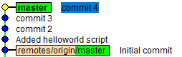
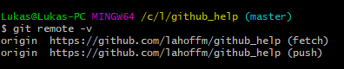
Delete branch & push to Github repo
git branch –d develop – delete branch.
gitk -–all now shows:
git remote –v – origin is alias for Github repo you cloned from
git push origin master - push local branch called “master” to the “master” branch in the remote named “origin”
Notes:
Note: origin is not always the same as your Github repo! You can actually rename it to a different repo. Or, if you clone from someone else’s repo it will be their repo and not yours. But by default when you clone your own repo, git sets origin to that repo.

Slide 14
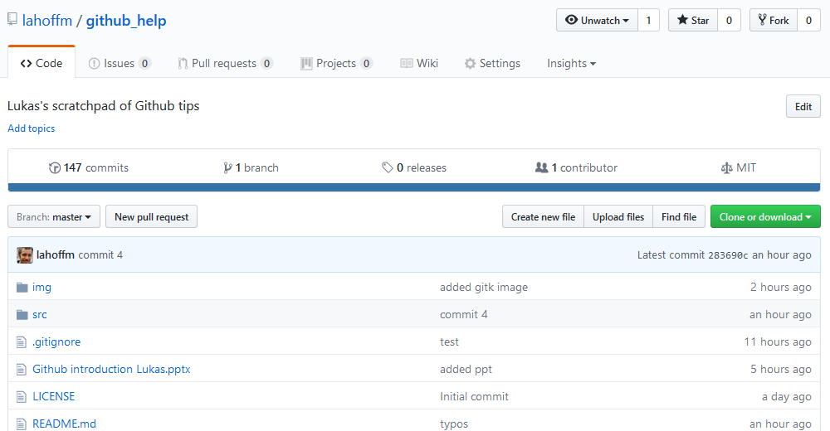
View changes in browser
Your online repo now has the src/helloworld.py file

Slide 15
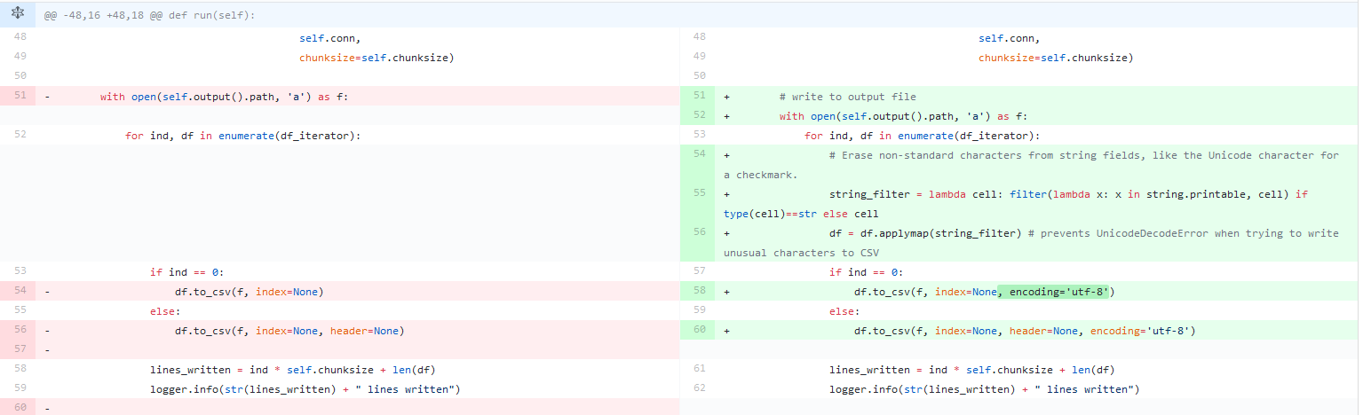
View code changes in browser
Above is from a more complicated example
Can also use git diff to see in command line
stackoverflow.com/questions/2529441/how-to-read-the-output-from-git-diff

Slide 16
More to learn!

Slide 17
Undo mistakes (only use locally)
github.com/blog/2019-how-to-undo-almost-anything-with-git
Restore a single file (use with caution)
git log –oneline – view identifiers for prior commits
git checkout c6fab02 src/helloworld.py – restore old version of file from previous commit
git commit –a –m “restore helloworld.py from commit that had SHA c6fab02”
Restore everything to where it was after a previous commit, as if later commits never happened (use with caution).
git reset --hard c6fab02
Make a new branch starting at a previous commit
git checkout c6fab02; git checkout –b mybranch
For undoing commits pushed to Github, safest to just fix it locally and push a new commit.
Notes:
Can undo mistakenly deleted branches (before you merged them) and mistaken git reset --hard using git reflog (but 30 day limit).
Another way to undo: git revert

Slide 18
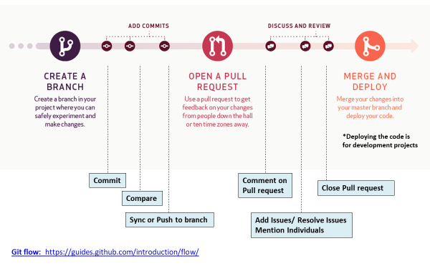
Moving toward collaboration
git remote/fetch/merge/push/pull/tag
Issues, branches, forks, merging, rebasing, pull requests, ...

